Slide 1
Natural Language Processing DSECL ZG565
Prof.Vijayalakshmi Anand
BITS-Pilani

Slide 2
Session 5-Parsing
Date – 27th sep 2020
Time – 9to 11am
These slides are prepared by the instructor, with grateful acknowledgement of James Allen and many others who made their course materials freely available online.

Slide 3

POS tagging
Approaches used in POS tagging
HMM
HMM tagger
Viterbi algorithm
Forward algorithm
Maximum entropy model

Slide 4
Session5:Parsing
Grammars and Sentence Structure
What Makes a Good Grammar
Parsing
A Top-Down Parser
A Bottom-Up Chart Parser
Top-Down Chart Parsing
Finite State Models and Morphological Parsing.

Slide 5
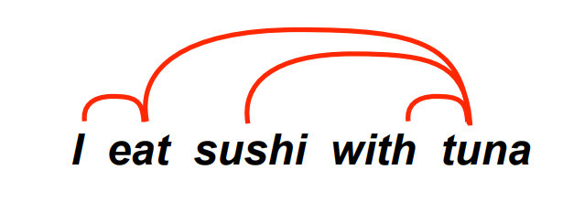
What is the structure of a sentence in natural language ?
Sentence structure is hierarchical:
A sentence consists of words (I, eat, sushi, with, tuna) ..which form phrases: “sushi with tuna”
Sentence structure defines dependencies between words or phrases:

Slide 6
How to compute the Sentence structure
To compute the syntactic structure ,must consider 2 things
Grammar
A precise way to define and describe the structure of the sentence
Parsing
The method of analyzing a sentence to determine its structure according to the grammar.

Slide 7
Why NLP needs grammars ?
Regular languages and part of speech refers to the way words are arranged together but cannot support easily: Constituency, Grammatical relations and Subcategorization and dependency relations
They can be modelled by grammars.

Slide 8
Applications -Machine translation
The output of current systems is often ungrammatical: Daniel Tse, a spokesman for the Executive Yuan said the referendum demonstrated for democracy and human rights, the President on behalf of the people of two. 3 million people for the national space right, it cannot say on the referendum, the legitimacy of Taiwan’s position full. (BBC Chinese news, translated by Google Chinese to E
Correct translation requires grammatical knowledge: English)

Slide 9
Question Answering
This requires grammatical knowledge.
..: John persuaded/promised Mary to leave.
Who left? ...
and inference: John managed/failed to leave. - Did John leave?
John and his parents visited Prague. They went to the castle.
Was John in Prague?
Has John been to the Czech Republic?
Has John’s dad ever seen a castle?

Slide 10
Contd..
Sentiment Analysis:
"I like Frozen"
"I do not like Frozen“
"I like frozen yogurt"
Relation Extraction:
"Rome is the capital of Italy and the region of Lazio".

Slide 11
Context free grammar
Simple yet powerful formalism to describe the syntactic structure of natural languages
• Developed in the mid-1950s by Noam Chomsky
• Allows one to specify rules that state how a constituent can be segmented into smaller and smaller constituents, up to the level of individual words

Slide 12
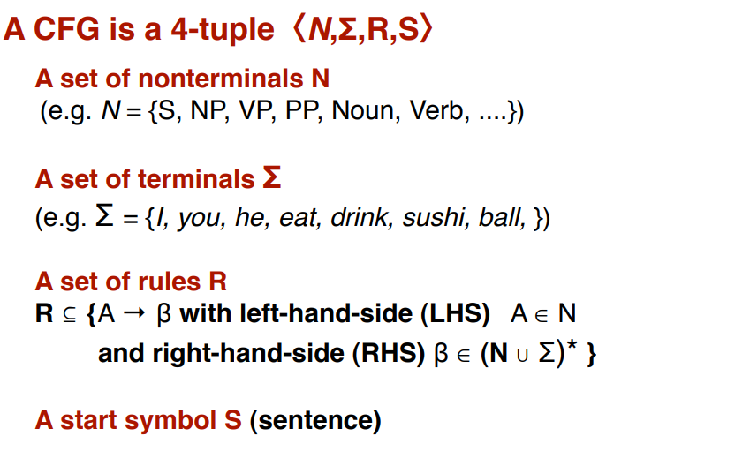
Context free grammar -Definition

Slide 13
Contd..
Terminals ∑
words - {sleeps, saw, man, woman, telescope, the, with, in}
Non-Terminals -N
The constituents in a language . Such as noun phrases, verb phrases and sentences
{S, NP, VP, PP, DT, Vi, Vt, NN, IN}
Rules
Rules are equations that consist of a single non-terminal on the left and any number of terminals and nonterminals on the right.

Slide 14
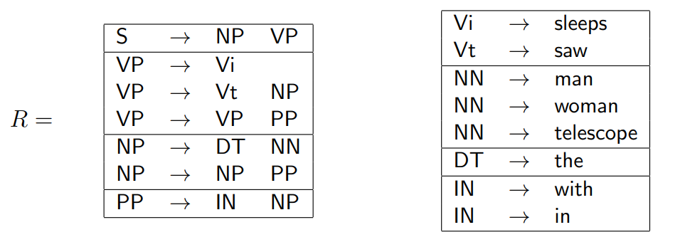
Some sample rules
lexicons
grammar

Slide 15
Categories of Phrases
Noun phrase (NP): Noun acts as the head word. They start with an article or noun.
Verb phrase (VP): Verb acts as the head word. They start with an verb
Adjective phrase (ADJP): Adjective as the head word. They start with an adjective
Adverb phrase (ADVP): Adverb acts as the head word. They usually start with an adjective
Prepositional phrase (PP): Preposition as the head word. They start with an preposition.

Slide 16
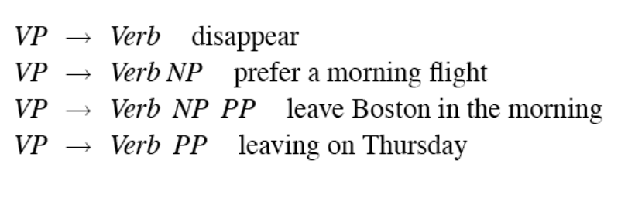
Verb phrase
English VPs consist of a head verb along with 0 or more following constituents which we’ll call arguments.

Slide 17
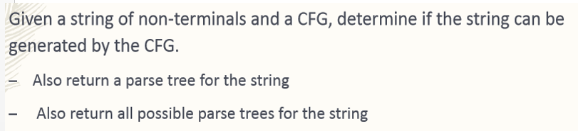
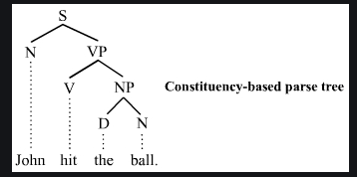
Parsing

Slide 18
Why parsing ?
Parsing adds information about sentence structure and constituents
Allows us to see what constructions words enter into
eg, transitivity, passivization, argument structure for verbs
Allows us to see how words function relative to each other
eg, what words can modify / be modified by other words

Slide 19
Parsing as a search procedure
Parsing as a special case of a search problem as defined in Al.
1. Select the first state from the possibilities list (and remove it from the list).
2. Generate the new states by trying every possible option from the selected state (there may be none if we are on a bad path).
3. Add the states generated in step 2 to the possibilities list.

Slide 20
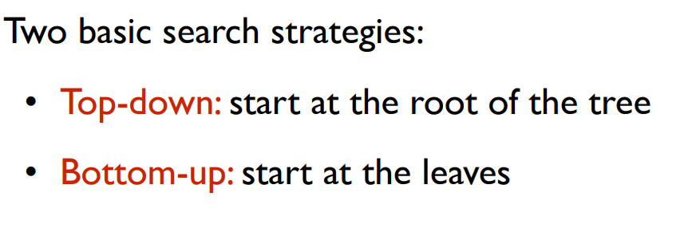
Two types of Parsing

Slide 21
A Simple Top-Down Parsing Algorithm
The algorithm starts with the initial state ((S) 1) and no backup states.
Take the first state off the possibilities list and call it C. IF the list is empty, THEN fails
IF C consists of an empty symbol list and the word position is at the end of the sentence, THEN succeeds
OTHERWISE, generate the next possible states.
IF the first symbol of C is a lexical symbol, AND the next word in the sentence can be in that class,
THEN – create a new state by removing the first symbol
updating the word position
add it to the possibilities list.
OTHERWISE, IF the first symbol of C is a non-terminal THEN – generate a new state for each rule that can rewrite
that non-terminal symbol
add them all to the possibilities list

Slide 22
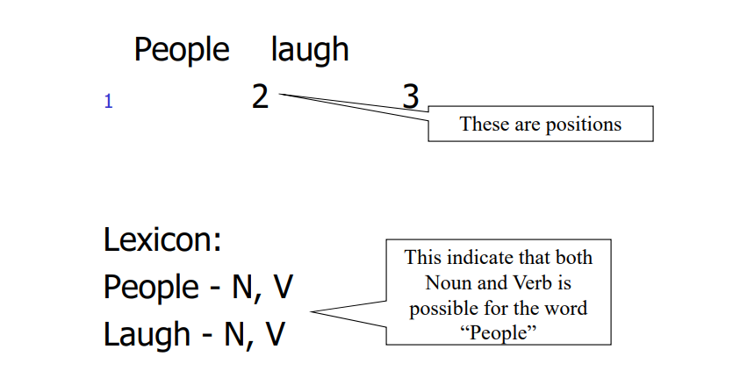
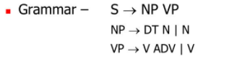
Toy example

Slide 23
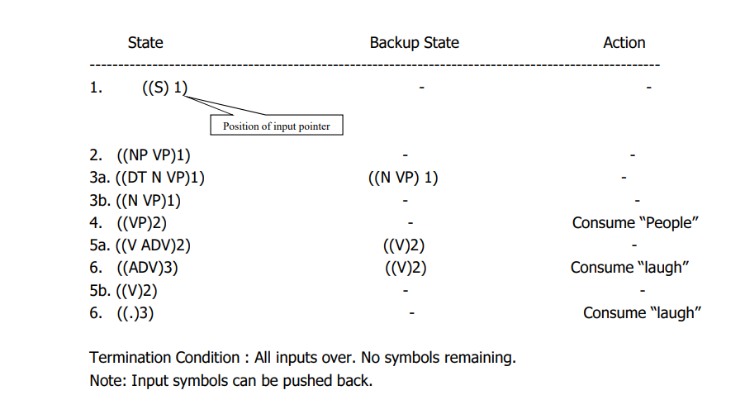
Contd..

Slide 24
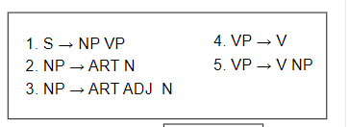
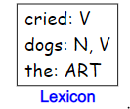


Example2
“₁ The ₂ dogs ₃ cried ₄”
“₁ The ₂ old ₃ man ₄ cried ₅”

Slide 25
Example- “The dogs cried”
Step 1. | Current State ((S) 1) | Backup States | Comment initial position
2. | ((NP VP) 1) |  | rewrite S by rule 1
3. | ((ART N VP) 1) |  | rewrite NP by rules 2&3
 |  | ((ART ADJ N VP) 1)
4. | ((N VP) 2) |  | match ART with the
 |  | ((ART ADJ N VP) 1)
5. | ((VP) 3) |  | match N with dogs
 |  | ((ART ADJ N VP) 1)
6. | ((V) 3) |  | rewrite VP by rules 4&5
 |  | ((V NP) 3)
 |  | ((ART ADJ N VP) 1)
7. | ( ) |  | the parse succeeds as V
 |  |  | is matched to cried

Slide 26
Example-“The old man cried”
Step Current State Backup States
1. ((S) 1)
Comment
initial position
S rewritten to NP VP
NP rewritten by rules 2&3
2. ((NP VP) 1)
3. ((ART N VP) 1)
((ART ADJ N VP) 1)
((ART ADJ N VP) 1) ((ART ADJ N VP) 1) ((V NP) 3)
((ART ADJ N VP) 1)
4. ((N VP) 2)
5. ((VP) 3)
6. ((V) 3)
VP rewritten by rules 4&5
7. (( ) 4)
((V NP) 3)
((ART ADJ N VP) 1)
((ART ADJ N VP) 1)
8. ((V NP) 3)
the first backup is chosen

Slide 27
con’t
Step Current State
9. ((NP) 4)
10. ((ART N) 4)
Backup States
((ART ADJ N VP) 1)
((ART ADJ N) 4) ((ART ADJ N VP) 1)
Comment
looking for ART fails
((ART ADJ N) 4)
((ART ADJ N VP) 1)
((ADJ N VP) 2) 14. ((N VP) 3)
15. ((VP) 4)
16. ((V) 4)
fails again
exploring backup state saved in step 3
((ART ADJ N VP) 1)
((V NP) 4)
17. (( ) 5)
success!

Slide 28
Bottom up parsing
The basic operation in bottom-up parsing is to take a sequence of symbols and match it to the right-hand side of the rules.
You could build a bottom-up parser simply by formulating this matching process as a search process.
The state would simply consist of a symbol list, starting with the words in the sentence.
Successor states could be generated by exploring all possible ways to
Rewrite a word by its possible lexical categories
Replace a sequence of symbols that matches the right-hand side of a grammar rule by its left-hand side symbol

Slide 29
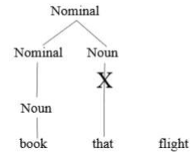
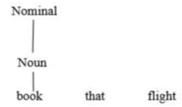

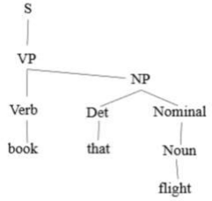
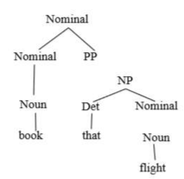
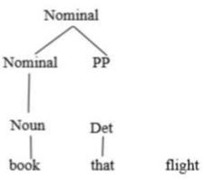
Bottom up parsing

Slide 30
Top Down vs Bottom Up
Top down never explores options that will not lead to a full parse, but can explore many options that never connect to the actual sentence.
Bottom up never explores options that do not connect to the actual sentence but can explore options that can never lead to a full parse.
Relative amounts of wasted search depend on how much the grammar branches in each direction.

Slide 31
Chart parsing
Parser would tend to try the same matches again and again, thus duplicating much of its work unnecessarily.
To avoid this problem, a data structure called a chart is introduced that allows the parser to store the partial results of the matching it has done so far so that the work need not be reduplicated.

Slide 32
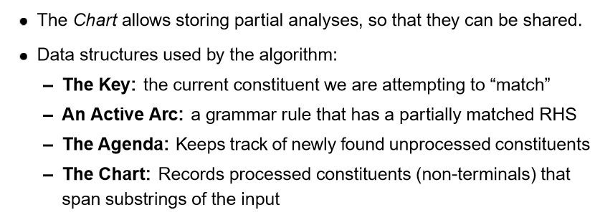
Chart Parsing

Slide 33
Chart Parsing
Assume you are parsing a sentence that starts with an ART.
With this ART as the key, rules 2 and 3 are matched because they start with ART.
To record this for analyzing the next key, you need to record that rules 2 and 3 could be continued at the point after the ART.
You denote this fact by writing the rule with a dot (o), indicating what has been seen so far. Thus you record
2'. NP -> ART o ADJ N
3'. NP -> ART o N
If the next input key is an ADJ, then rule 4 may be started, and the modified rule 2 may be extended to give
2''. NP -> ART ADJ o N

Slide 34
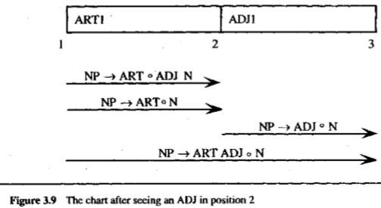
Chart- active arcs
The chart maintains the record of all the constituents derived from the sentence so far in the parse.
Maintains the record of rules that have matched partially but are not complete. These are called the active arcs.

Slide 35
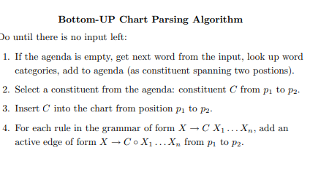
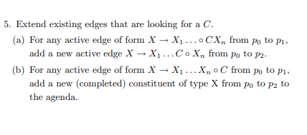
The Chart Parsing Algorithm

Slide 36
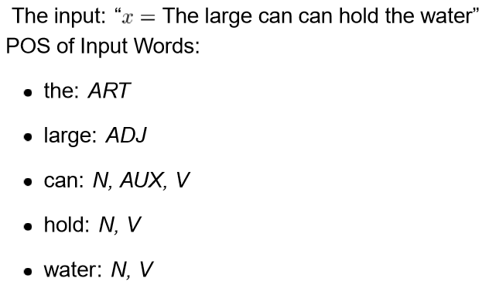
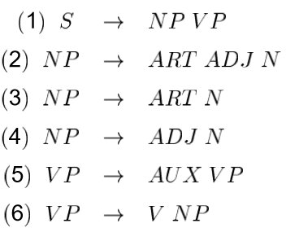
Chart parsing example

Slide 37
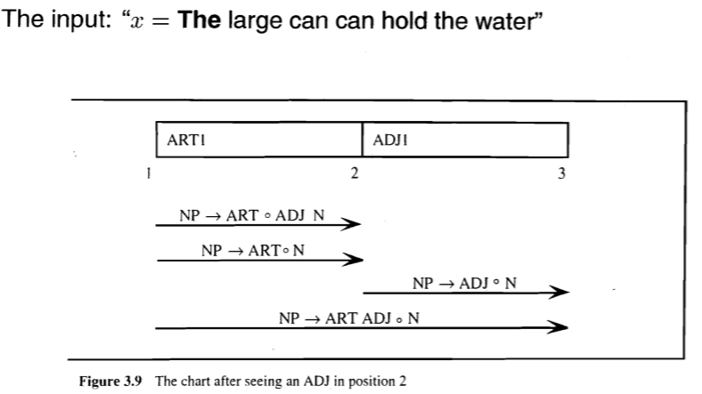
Chart parsing example

Slide 38
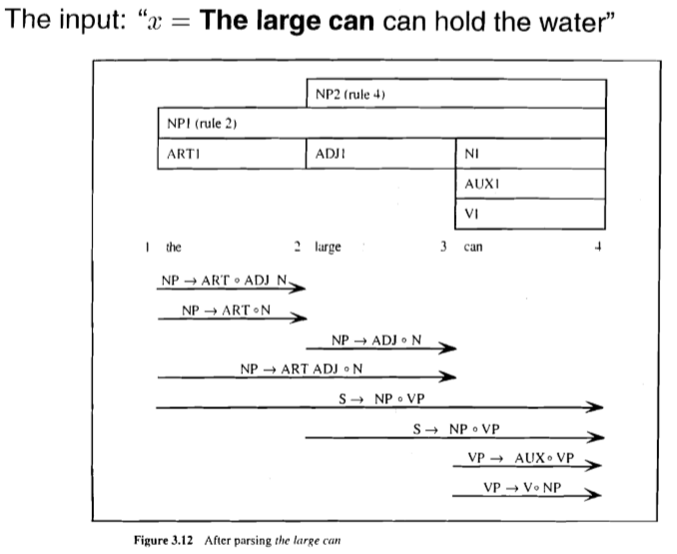
Chart parsing example

Slide 39
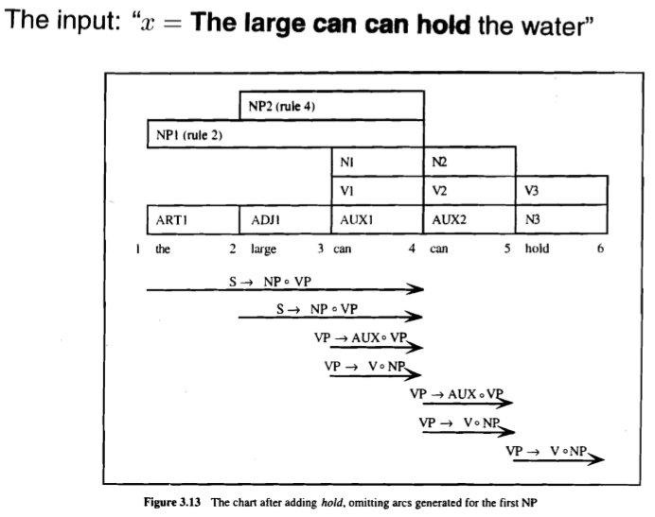
Chart parsing example

Slide 40
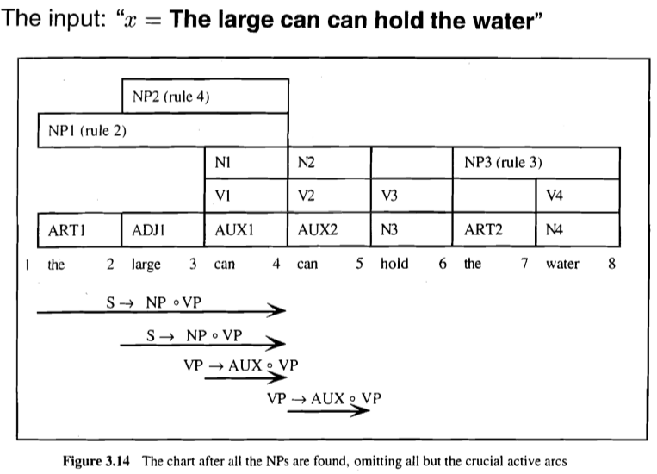
Chart parsing example

Slide 41
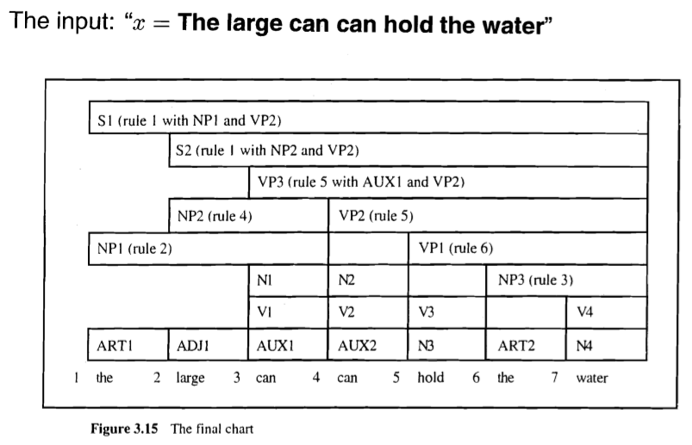
Final Chart

Slide 42
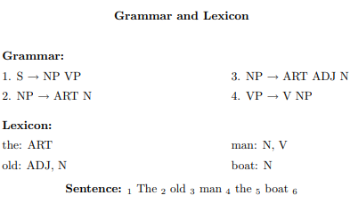
Example2

Slide 43
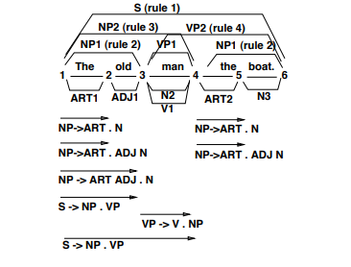
Contd..

Slide 44
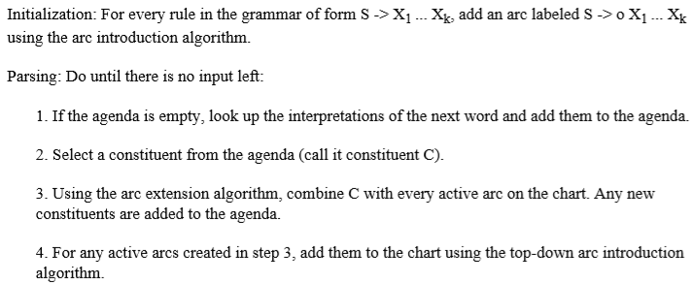
Top down chart parsing

Slide 45
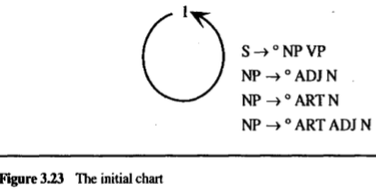
Top down chart parsing example

Slide 46
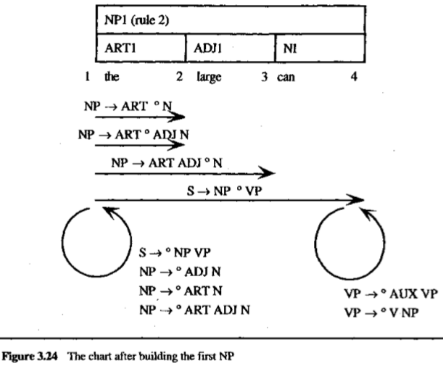
Top down chart parsing example

Slide 47
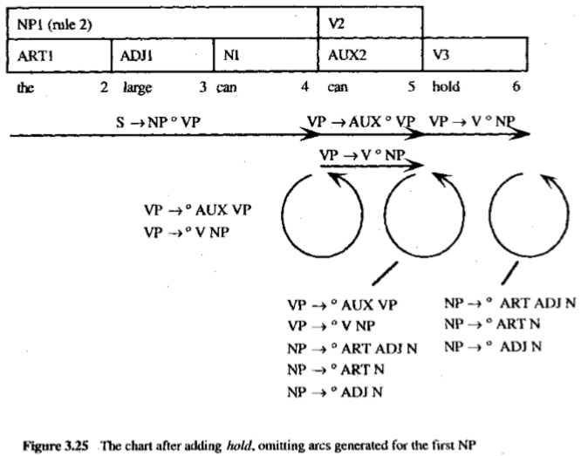
Top down chart parsing example

Slide 48
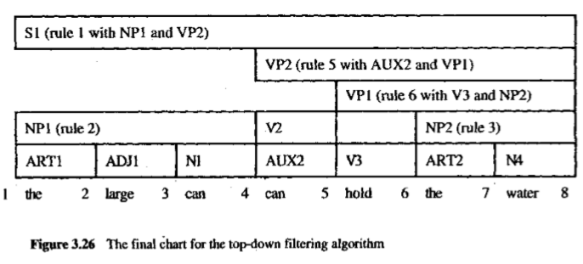
Top down chart parsing example

Slide 49
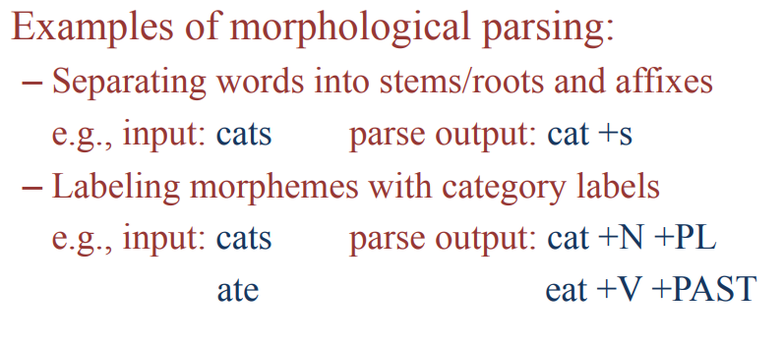
Morphological Parsing
Not only are there a large number of words, but each word may combine with affixes to produce additional related words.
One way to address this problem is to preprocess the input sentence into a sequence of morphemes.
A word may consist of single morpheme, but often a word consists of a root form plus an affix. .

Slide 50
Components of Morphological parsing
Lexicon
Morphotactic
Orthographic rules

Slide 51
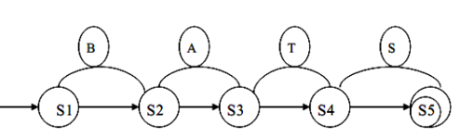
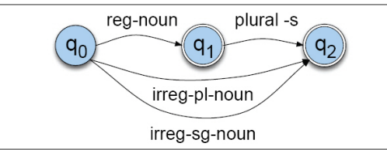
Finite state automation

Slide 52
Finite State Transducers
The simple story
Add another tape
Add extra symbols to the transitions
On one tape we read “cats”, on the other we write “cat +N +PL”, or the other way around.

Slide 53
FSTs

Slide 54
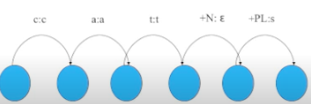
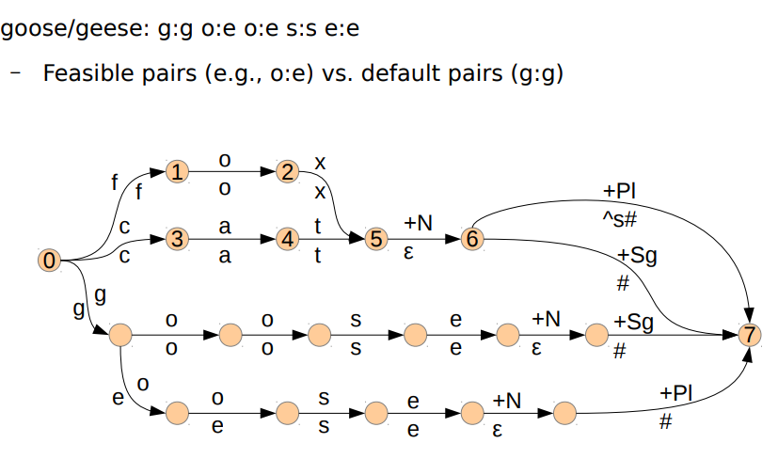
Example

Slide 55
Parsing/Generation vs. Recognition
Recognition is usually not quite what we need.
Usually if we find some string in the language we need to find the structure in it (parsing)
Or we have some structure and we want to produce a surface form (production/generation)
Example
From “cats” to “cat +N +PL” and back
Morphological analysis

Slide 56
Stemming in IR
Run a stemmer on the documents to be indexed
Run a stemmer on users queries
Match
This is basically a form of hashing
Example: Computerization
ization -> -ize computerize
ize -> ε computer

Slide 57
Errors in Stemming:
There are mainly two errors in stemming –
over-stemming
under-stemming

Slide 58
Porter
No lexicon needed
Basically a set of staged sets of rewrite rules that strip suffixes
Handles both inflectional and derivational suffixes
➔Doesn’t guarantee that the resulting stem is really a stem (see first bullet)
➔Lack of guarantee doesn’t matter for IR

Slide 59
Porter Stemmer
Errors of Omission
European Europe
analysis analyzes
matrices matrix
noise noisy
explain explanation
Errors of Commission
organization organ
doing doe
generalization generic
numerical numerous
university universe

Slide 60
References
Speech and Language processing: An introduction to Natural Language Processing, Computational Linguistics and speech Recognition by Daniel Jurafsky and James H. Martin
Natural language understanding by James Allen

Slide 61
Thank You… ☺
Q&A
Suggestions / Feedback

